Slide 1

DriverPass System Analysis
Jason Pullara
Notes:
[No speaker notes required for this slide.]

Slide 2

System Requirements
System shall allow customers to register and create accounts where they can manage their information, book driving lessons, and access training material.
System shall allow instructors to log in, view, and manage lessons and input feedback for each lesson.
System shall ensure user data protection by complying with security standards.
System shall be available for use 24/7 with a minimum update of 99.9% excluding planned downtimes.
Notes:
[In your speaker notes, include an explanation of the different requirements you determined for DriverPass’s system. What are the functional requirements you selected to describe? What are the nonfunctional requirements you selected to describe? Be sure to explain how these requirements meet DriverPass’s needs.]
Functional Requirements.
Customer Account Management.
Requirement: System shall allow customers to register and create accounts where they can manage their information, book driving lessons, and access training material
This requirement is necessary for DriverPass. The system cannot operate without a functional customer account management system. Customers must be able to log in, create accounts, and manage those accounts.
Instructor Access.
Requirement: System shall allow instructors to log in, view, and manage lessons and input feedback for each lesson
Instructors are the second half of the DriverPass formula. This requirements outlines the tools they need to manage their time, their lessons, and the feedback they give to students.
Nonfunctional Requirements.
Data Security.
Requirement: System shall ensure user data protection by complying with security standards.
Security is essential when dealing with private user data, such as financial information. DriverPass must not only protect the data in an industry compliant way but also must store data in such a way that protects against security breaches.
System Availability.
Requirement: System shall be available for use 24/7 with a minimum update of 99.9% excluding planned downtimes.
An online service like DrivePass must meet customer expectations of being available at any time, including during non-business hours.

Slide 3
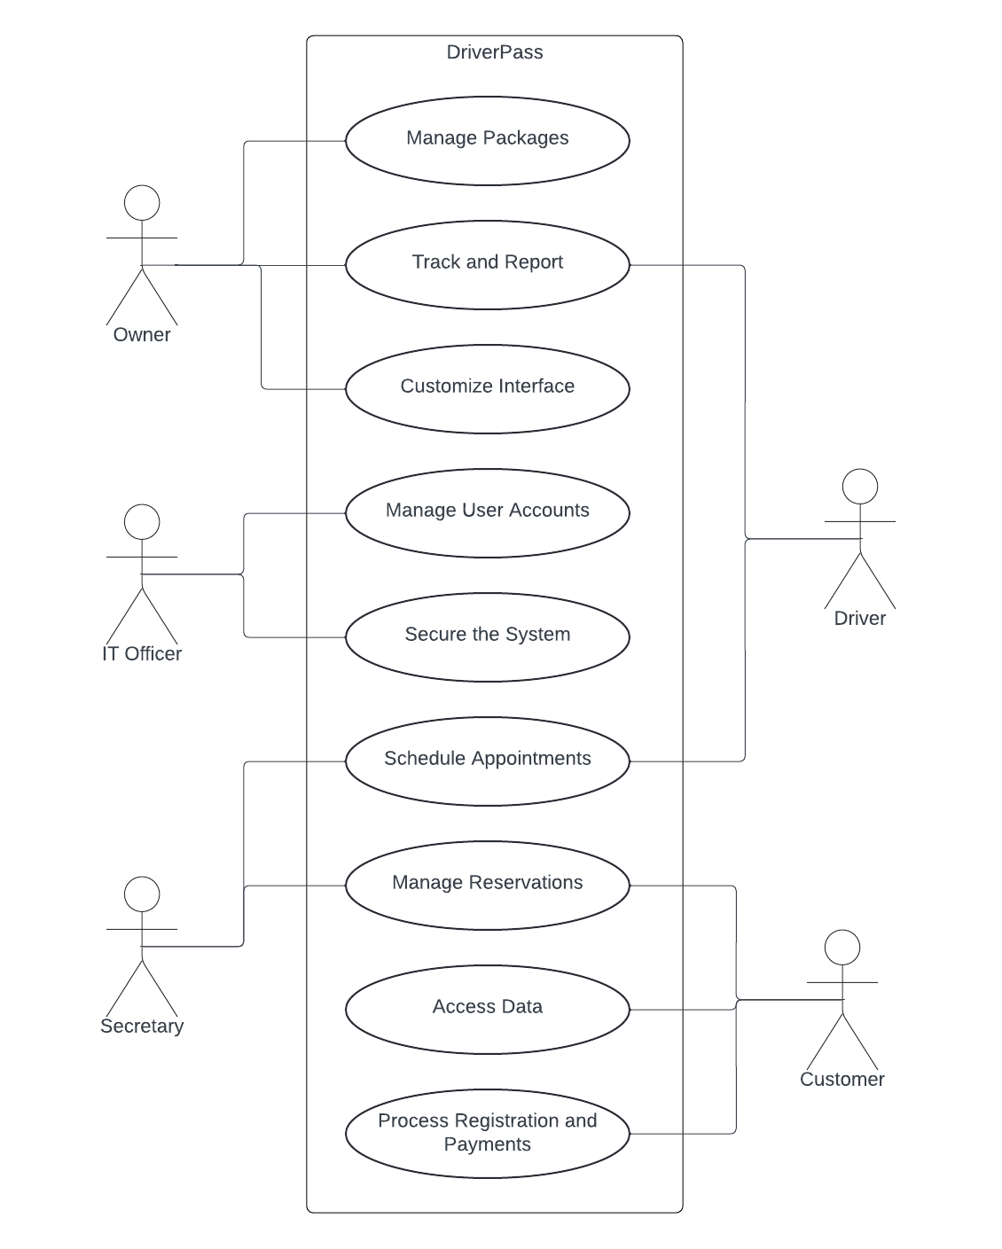
Use Case Diagram
Notes:
[Explain your diagram. Who are the different actors in the system? What are the different use cases? How did you account for DriverPass’s needs in your design? In your explanation, keep your audience in mind. Avoid the use of terms like “actors” and “use cases” in your explanation.]
This diagram illustrates the roles within DriverPass. They include the Owner, IO Officer, Secretary, Drivers, and Customers, which all have different responsibilities.
The owner is responsible for overseeing package management, ensuring the offerings are relevant and industry competitive. They also have access to reporting features, so they have a clear understanding of the business’ performance. They can also customize the system interface to suit the business needs.
The IT Officer maintains user accounts and ensures each user can only access the areas of the system that are role appropriate. They maintain the system integrity and protect sensitive information from unauthorized access.
The Secretary schedules appointments for customers and drivers and manages those reservations.
The Driver provides on the road training and uses the system to track their schedule and which customers they will teach.
The Customer uses the system to access their data, including driving lessons and training materials.
DriverPass’ needs were met by ensuring that each role had specific activities tailored to their part of the business. The system is organized in a way that provides an easy to navigate workflow, which allows for a more efficient, secure, and user-friendly experience for everyone involved.

Slide 4
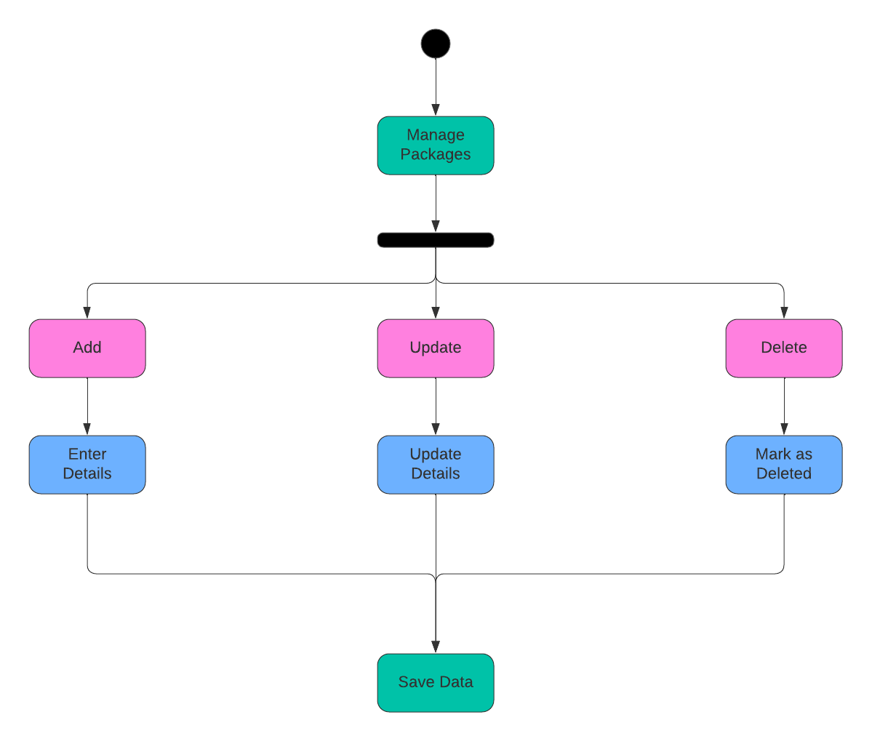
Activity Diagram
Notes:
[Explain your diagram. Which use case are you breaking down? What are the steps for this use case? How did you account for DriverPass’s needs in your design? In your explanation, keep your audience in mind. Avoid the use of technical terms such as “nodes,” “control flows,” and so on.]
This represents the steps someone at DriverPass, like an Owner, would take to manage the different training packages.
The user would Add a new package. They would enter all details for the new package, such as what it includes, the price, and duration.
The user would Update an existing package. If there is already an existing package, the user can update the details, such as drive, duration, and included materials.
The user would Delete an existing package. If a package is no longer needed or outdates the user could choose to delete it. Instead of completely removing it from the system, which could affect records, the system marks it as deleted and hides it from new and existing customers.
After any of these actions, the system will save or update the information in the database. This accounts for the needs of DriverPAss by allowing for dynamic management of the service offerings, allowing for fast updates to the system in the face of rapidly changing business dyanmics.

Slide 5
Security
Encryption
Access Controls
Authentication
Activity Logs
Regular Updates
Data Backups
Anti-Brute Force
Security Training
Monitoring Systems
Notes:
[How did you consider security in your design? In your explanation, keep your audience in mind by avoiding the use of technical terms.]
When creating the DrivePass system I focused on including features that keep information secure by separating security needs out into different compartments.
Information sent over the internet – all data sent over the internet is scrambled in a way that only the intended recipients can read it.
Levels of Access – Not everyone in a company has keys to every door of the building, so different levels of access help keep users accessing only the portions of the system that they’re meant to.
Multiple checks – The system does multiple checks to make sure that users are who they say they are, including asking for passwords in addition to things like security codes sent to their phones to verify identities.
Staying vigilante – The system watches for unusual activity and reports it to the IT staff if it notices something wrong or out of place.
Staying updates – IT staff makes sure the system stays updated so that the latest issues (vulnerabilities, bugs, etc.) can be addressed promptly.
Backups – In the event of a catastrophic failure of some kind, backups are kept to ensure that the system can be brought back online in a timely manner.

Slide 6
System Limitations
Internet connectivity dependency
Modern technology requirement
Learning curve
Maintenance downtime
Scalability
Security measures vs UX
Data privacy regulations
Notes:
[What are the limitations of your design? In your explanation, keep your audience in mind by avoiding the use of technical terms.]
Need for good internet connection – the system works online, and it requires that the user has a decent internet connections. If their connection is down or not working well, the system will be unavailable.,
Modern devices requires – older systems and cell phones may be incompatible with DriverPass as it uses modern tools that rely on updated systems.
Learning to use the system – despite our best efforts, users will still need to learn how to use the system and may face difficulties in taking advantage of DriverPass.
Occasional updates – the system needs to be updated regularly, and during those regular maintenance periods DriverPass will be unavailable.
Number of users – If the company grows too quickly big updates may be required to keep everything running smoothly.
Safety versus Ease of Use – To keep information safe we sometimes add extra steps which may be detrimental to easily using DriverPass.
Regulations – DriverPass goes out of its way to ensure compliance with government regulations, even to the detriment of being able to easily use the system in some cases.

